Slide 1


Selenium WebDriver
Locators
RegEx basics

Slide 2
AGENDA
Overview: what is WebDriver?
How it works?
Web DevTools
Locators
RegEx basics

Slide 3

PART 1:
WHAT IS WEBDRIVER?

Slide 4

WHAT IS WEBDRIVER? WHAT IS SELENIUM?
Selenium is a project name, within which a series of software products is developed:
Selenium IDE (Firefox plugin, that records and reproduces user actions)
Selenium RC (the previous version of the library for browser management = Selenium )
Selenium Server standalone (lets you control the browser from a remote machine over the network)
Selenium WebDriver (library for browser management)
Selenium Grid (cluster consisting of several Selenium Servers)
Open source project (Apache 2.0 license)

Slide 5

WHAT IS WEBDRIVER? SELENIUM HISTORY
Developed by Jason Huggins in 2004 at ThoughtWorks company
In 2004, Paul Hammant joined the team and steered the development of the second mode of operation - Selenium Remote Control (Selenium RC)
In 2005, Dan Fabulich and Nelson Sproul made a series of patches that transformed Selenium-RC into what it became best known for.
In 2007, Huggins joined Google, where he continued with the development and stabilization of Selenium RC
In 2007, Simon Stewart at ThoughtWorks developed WebDriver
In 2008, Philippe Hanrigou (then at ThoughtWorks) made Selenium Grid
In 2009, after a meeting between the developers at the Google Test Automation Conference Google Selenium RC and ThoughtWorks WebDriver projects were merged -> Selenium WebDriver (or Selenium 2.0) was born
In 2016 Selenium 3.0 was released.
Why the name is ‘Selenium’?
Notes:
Mercury is a company that produces interactive testing solutions (Test Director for instance) - and they charge a lot of money for these tools. You can get involved in the forum811: Mercury Interactive Testing solutions for this if you like. Seleniuim is open source - and as such costs you nothing. Selenium, as the chemists amongst you may be aware, is the antidote to Mercury poisoning. In the context of this open source tool, Open QA Selenium is the "antidote" to the commercial Mercury product line.

Slide 6


WHAT IS WEBDRIVER? SELENIUM FUTURE – 3.0
Selenium 3.0 – was released in 2016..
https://github.com/SeleniumHQ/selenium/wiki/Shipping-Selenium-3
https://www.joecolantonio.com/2016/05/31/selenium-3-sneak-peak/
W3C Working Draft 09 November 2015
WebDriver is a remote control interface that enables introspection and control of user agents. It provides a platform- and language-neutral wire protocol as a way for out-of-process programs to remotely instruct the behavior of web browsers.
The standard forms part of the Web Testing Activity.

Slide 7
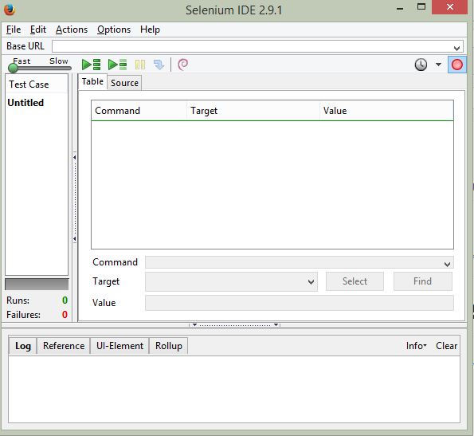

WHAT IS WEBDRIVER? SELENIUM IDE
Selenium IDE – Mozilla Firefox extension
http://www.seleniumhq.org/download/
Capabilities:
record and playback simple tests
simple assertions
export generated code
Usually is used for
Selenium automation get stared
Create a small scenario for quick bug replication
Auxiliary script to avoid routine during manual testing
Doesn’t require any programming skills
Has a lot of plugins, that may significantly extend Selenium IDE capabilities

Slide 8
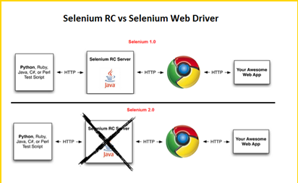
SELENIUM WEBDRIVER VS. SELENIUM RC
Selenium RC sends commands to browsers via JavaScript (Selenium Core)
Selenium WebDriver sends commands to browsers using browser native interfaces
Notes:
Scripts may be automatically recorded and edited manually providing autocompletion support and the ability to move commands around quickly. Scripts are recorded in Selenese, a special test scripting language for Selenium. Selenese provides commands for performing actions in a browser (click a link, select an option), and for retrieving data from the resulting pages.
Selenium client API[edit]
As an alternative to writing tests in Selenese, tests can also be written in various programming languages. These tests then communicate with Selenium by calling methods in the Selenium Client API. Selenium currently provides client APIs for Java, C#, Ruby and Python.
With Selenium 2, a new Client API was introduced (with WebDriver as its central component). However, the old API (using class Selenium) is still supported.
Selenium Remote Control[edit]
Selenium Remote Control (RC) is a server, written in Java, that accepts commands for the browser via HTTP. RC makes it possible to write automated tests for a web application in any programming language, which allows for better integration of Selenium in existing unit test frameworks. To make writing tests easier, Selenium project currently provides client drivers for PHP, Python, Ruby, .NET, Perl and Java. The Java driver can also be used with JavaScript (via the Rhino engine). A new instance of selenium RC server is needed to launch html test case - which means that the port should be different for each parallel run.^{[citation needed]} However, for Java/PHP test case only one Selenium RC instance needs to be running continuously.^{[citation needed]}
Selenium Remote Control was a refactoring of Driven Selenium or Selenium B designed by Paul Hammant, credited with Jason as co-creator of Selenium. The original version directly launched a process for the browser in question, from the test language of Java, .Net, Python or Ruby. The wire protocol (called 'Selenese' in its day) was reimplemented in each language port. After the refactor by Dan Fabulich, and Nelson Sproul (with help from Pat Lightbody) there was an intermediate daemon process between the driving test script, and the browser. The benefits included the ability to drive remote browsers, and the reduced need to port every line of code to an increasingly growing set of languages. Selenium Remote Control completely took over from the Driven Selenium code-line in 2006. The browser pattern for 'Driven'/'B' and 'RC' was response/request, which subsequently became known as Comet.
With the release of Selenium 2, Selenium RC has been officially deprecated in favor of Selenium WebDriver.
Selenium WebDriver[edit]
Selenium WebDriver is the successor to Selenium RC. Selenium WebDriver accepts commands (sent in Selenese, or via a Client API) and sends them to a browser. This is implemented through a browser-specificbrowser driver, which sends commands to a browser, and retrieves results. Most browser drivers actually launch and access a browser application (such as Firefox or Internet Explorer); there is also an HtmlUnitbrowser driver, which simulates a browser using HtmlUnit.
Unlike in Selenium 1, where the Selenium server was necessary to run tests, Selenium WebDriver does not need a special server to execute tests. Instead, the WebDriver directly starts a browser instance and controls it. However, Selenium Grid can be used with WebDriver to execute tests on remote systems (see below).
In practice, this means that the Selenium 2.0 API has significantly fewer calls than does the Selenium 1.0 API. Where Selenium 1.0 attempted to provide a rich interface for many different browser operations, Selenium 2.0 aims to provide a basic set of building blocks from which developers can create their own Domain Specific Language. One such DSL already exists: the Watir project in the Ruby language has a rich history of good design. Watir-webdriver implements the Watir API as a wrapper for Selenium-Webdriver in Ruby. Watir-webdriver is created entirely automatically, based on the WebDriver specification and the HTML specification.
As of early 2012, Simon Stewart (inventor of WebDriver), who was then with Google and now with Facebook, and David Burns of Mozilla were negotiating with the W3C to make WebDriver an internet standard. In July 2012, the working draft was released. Selenium-Webdriver (Selenium 2.0) is fully implemented and supported in Python, Ruby, Java, and C#.
Selenium Grid[edit]
Selenium Grid is a server that allows tests to use web browser instances running on remote machines. With Selenium Grid, one server acts as the hub. Tests contact the hub to obtain access to browser instances. The hub has a list of servers that provide access to browser instances (WebDriver nodes), and lets tests use these instances. Selenium Grid allows running tests in parallel on multiple machines, and to manage different browser versions and browser configurations centrally (instead of in each individual test).
The ability to run tests on remote browser instances is useful to spread the load of testing across several machines, and to run tests in browsers running on different platforms or operating systems. The latter is particularly useful in cases where not all browsers to be used for testing can run on the same platform.

Slide 9
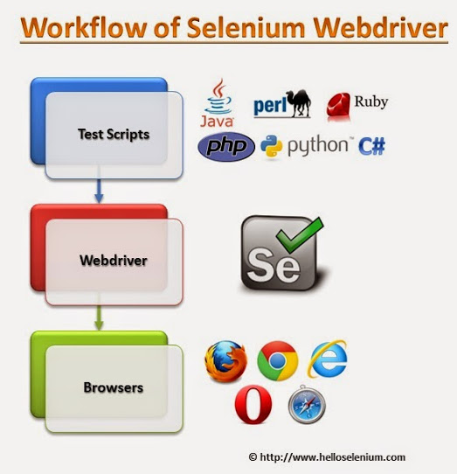
WHAT IS WEBDRIVER? WORKFLOW
An automation developer creates a scenario in any high level language (using a corresponding library)
The scenario is accepted by WebDriver and transformed into the language, that a particular browser (depends on WebDriver type) understands
Browser performs the manipulations, that were described in the first step

Slide 10
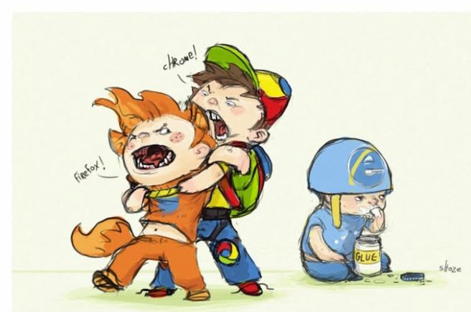
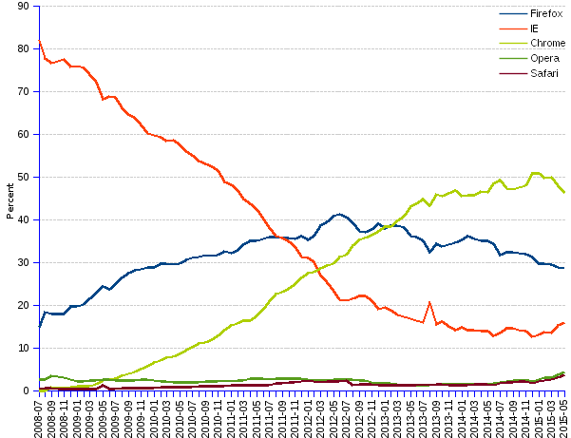
SUPPORTED BROWSERS
Wide variety of browsers supported:
Firefox (all the version, where Selenium IDE is available)
IE (7-10, 11 – additional configuration required)
Edge (not all major features yet implemented)
Safari (5.1+)
Opera (Opera Software)
Chrome (Chromium)

Slide 11
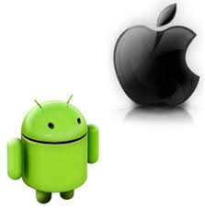

SUPPORTED PLATFORMS
Windows
Linux
Mac OS
OS X
Solaris
Android
iOS

Slide 12
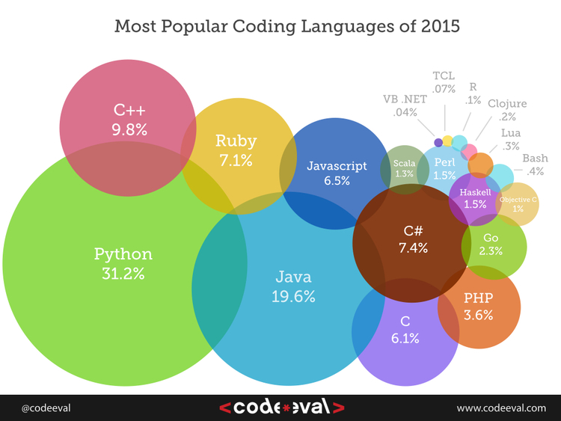
SUPPORTED PROGRAMMING LANGUAGES
Programming languages (+ frameworks)
Java (JUnit, TestNG)
JavaScript (WebdriverJS, WebdriverIO, NightwatchJS)
C# (NUnit)
Objective-C
Perl
PHP (Behat + Mink)
Python (unittest, pyunit, py.test, robot framework)
Ruby (RSpec, Test::Unit)

Slide 13
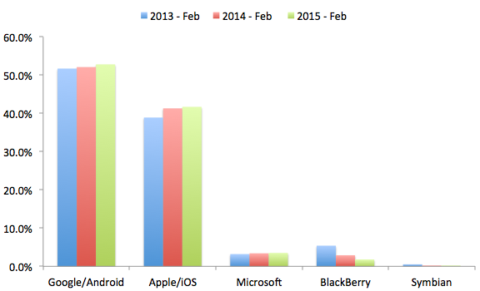
WHAT IS WEBDRIVER? MOBILE SUPPORT
Mobile Drivers:
Windows Phone
Selendroid (real Android devices and emulators)
Appium (iOS and WebDriver using WebDriver protocol)
iOs-driver
BlackBerry 10

Slide 14
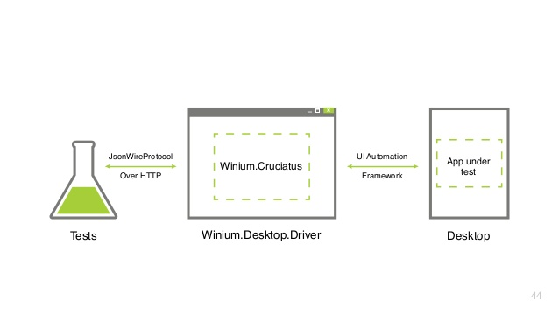
WHAT IS WEBDRIVER? WINIUM
Win-desktop + Selenium (http-client)
How to start with Winium:
download the latest driver;
Launch the driver with administrator privileges;
Select your favorite programming language and IDE;
How to get locators:
1) UISpy;
2) UI Automation Verify
(more handy + better performance)
Do not touch your mouse, then a case is started
Locators:
- AutomationProperties.AutomationId
- Name
- ClassName

Slide 15
WHAT IS WEBDRIVER? PROS AND CONS
Pros | Cons
Selenium is pure open source, freeware and portable | Require expertise resources, well versed in frameworks
Supports a lot of languages (Java, C#, …) | Difficult to test image based applications
Supports many OS-s and browsers | Needs outside support for report generation
Can be integrated with Maven and ANT build tools | Does not support built in add-ins support
Can be integrated TestNG, NUnit, … | Does not provide any built in IDE
Can be integrated with Jenkins Hudson and other CI tools | Selenium Engineers are bit in scarcity these days
Can be used for mobile testing | Script creation time is bit high
Low CPU and RAM consumption | Partially supports for Dialog boxes
Faster test execution (in comparison with Selenium RC) | Some popular methods are missed - isElementPresent()
Doesn’t require Selenium Server (unlike Selenium RC) | Does not support file upload facility

Slide 16
PART 2:
HOW IT WORKS?

Slide 17
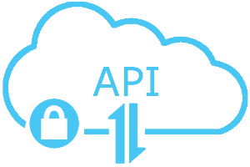
WEBDRIVER API
Interface WebDriver - represents an idealized web browser.
Methods can be used for:
control of the browser itself;
selection of WebElements
debugging aids
Key methods:
get(String url) - to load a new web page
findElement(By by) – to find an element on the page
close()
findElements(By by)
getCurrentUrl()
etc.

Slide 18
WEBDRIVER API. BROWSER INTERACTION
Java | C# | Description
close() | Close() | Close current window
findElement(By by) | FindElement(By by) | Find first WebElement By locator
findElements(By by) | FindElements(By by) | Find all WebElements By locator
get(String url) | Navigate().GoToURL(String url) | Open URL
getCurrentUrl() | GetCurrentUrl() | Get current URL
getPageSource() | GetPageSource() | Get Page source
getWindowHandle() | GetWindowHandle() | Get window descriptor
getWindowHandles() | GetWindowHandles() | Get window descriptors
manage() | Manage() | Managing the WebDriver
navigate() | Navigate() | Navigate backward and forward (History)
quite() | Quite() | Exit browser
switchTo() | SwitchTo() | Switch to frame or window
getTitle() | GetTitle() | Get current page title

Slide 19
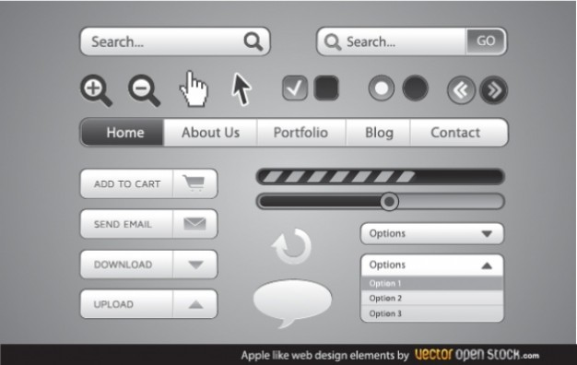
WEBDRIVER API. WEBELEMENT
Interface to represent an HTML element
Provides methods to interact with web page elements:
clear()
click()
findElement(By by)
findElements(By by)
getAttribute(String name)
getCssValue(String propertyName)
getLocation()
getSize()
getTagName()
getText()
isDisplayed()
isEnabled()
isSelected()
sendKeys(CharSequence... keysToSend)
submit()

Slide 20

WEBDRIVER API. NAVIGATION
Open Page URL
get(Strung url) / Get(String url)
Browser Navigation

Slide 21
Thanks for attention

